Slide 1
Ggplot2 and interactive graphics with R
Christophe Ladroue
SECTION 02
VIDEO 04
Histograms and Density plots
www.PacktPub.com

Slide 2
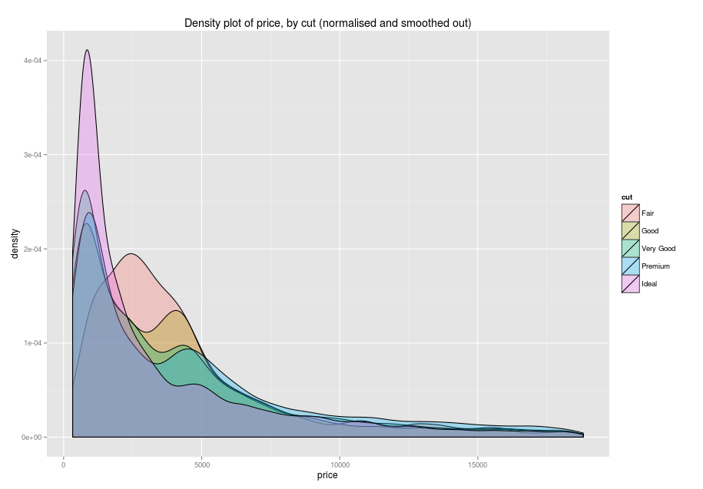
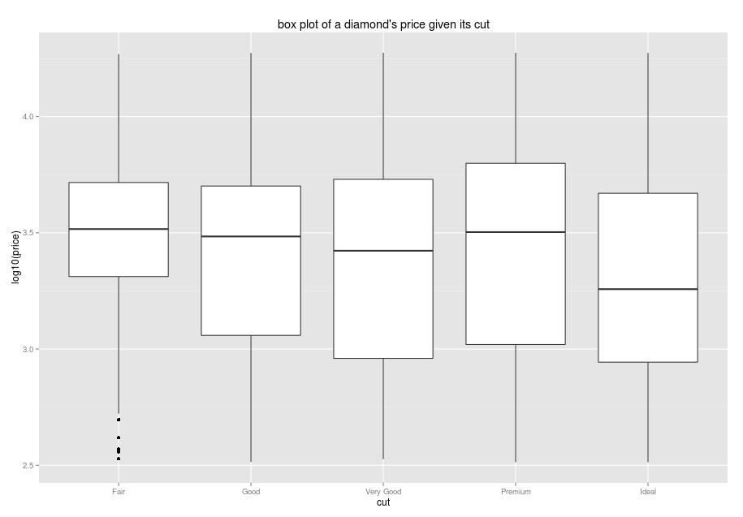
In this video we took a look at
how to make histograms and density plots.
how density plots can be visually compared.
Next: Boxplots

